Slide 1
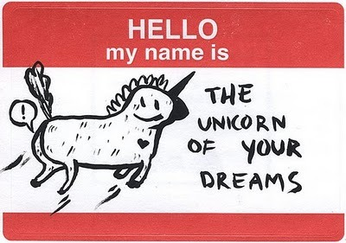
Advanced .Net Debugging
The secret sauce to become a rockstar ninja unicorn developer

Slide 2
Super exciting old technologies!
Visual Studio Code - Getting more out of old school VS
See what you want, inline, in real-time – Code Attributes
Do something with all those PDB files – Use the source, Luke
Go where no debugger has gone before – Debugging in production

Slide 3
Native Debugging
Performance

Slide 4

The Rainbow's ends of Unicorn Debuggers
"Select" isn’t broken
- The Pragmatic Programmer

Slide 5

The Rainbow's ends of Unicorn Debuggers
"Select" isn’t broken
- The Pragmatic Programmer
Sometimes it is
- Life

Slide 6
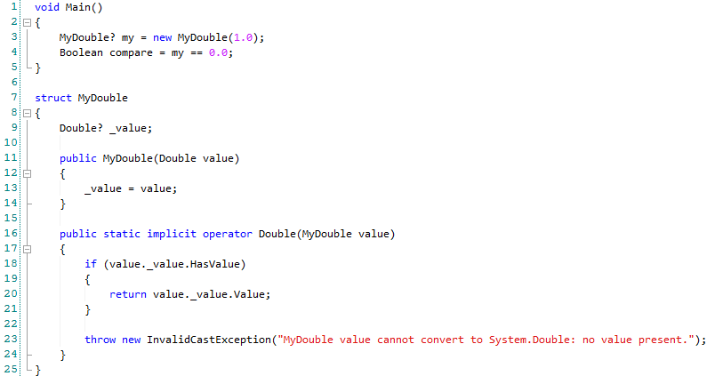
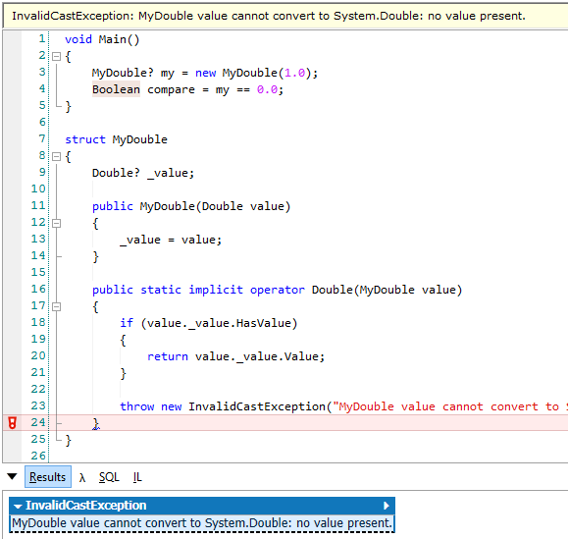
Which is this, and why?
Notes:
MyDouble.linq

Slide 7
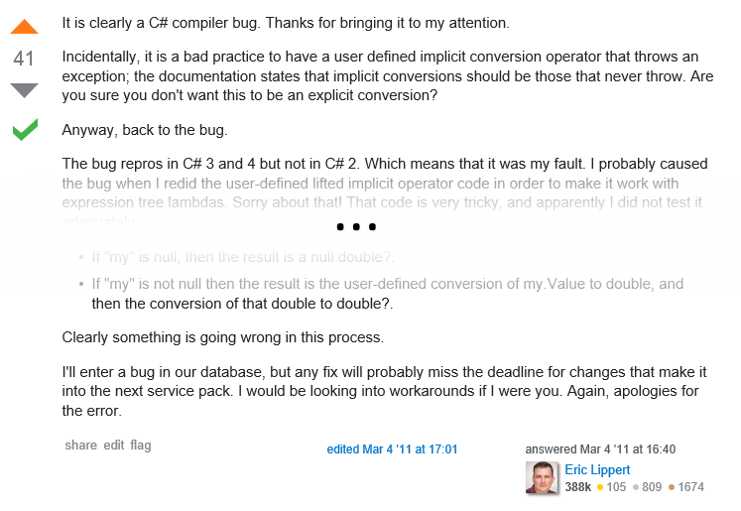
A broken select
http://stackoverflow.com/questions/5188671/

Slide 8
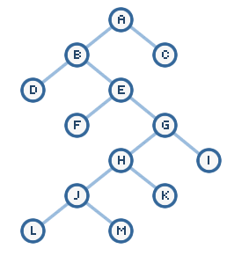
Find the path before time runs out
App
System
Besides psychic powers, tools and techniques are the surest way to increase debugging speed.

Slide 9
The Code
https://github.com/codekaizen/AdvNetDebugging/
Notes:
00:10

Slide 10
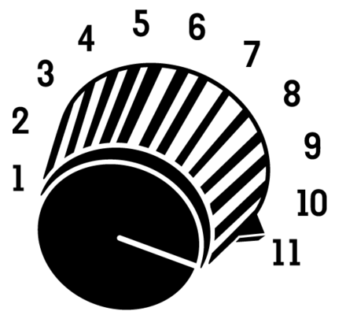
Visual Studio is like Visual Studio Code, with debugging

Slide 11
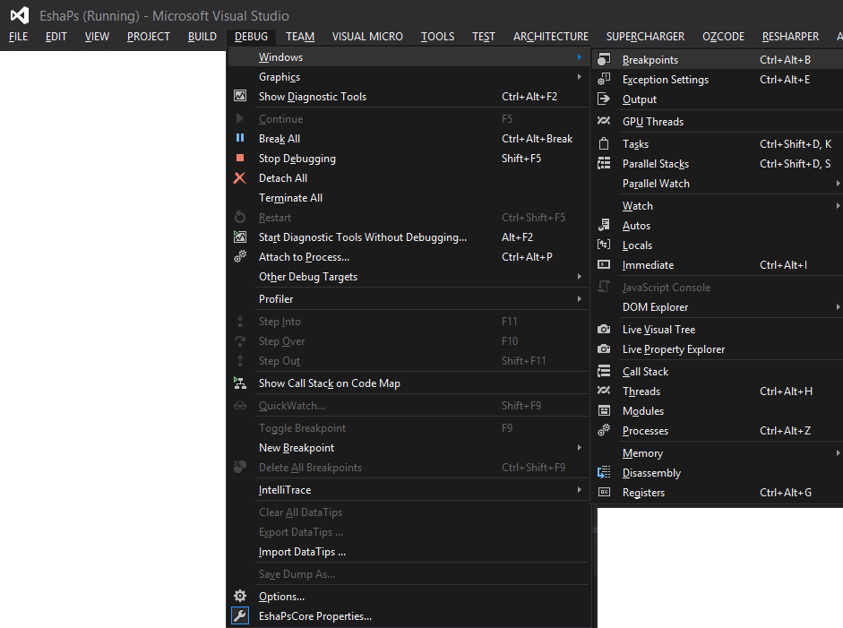
Useful VS tool windows
Debug Tool
Windows

Slide 12
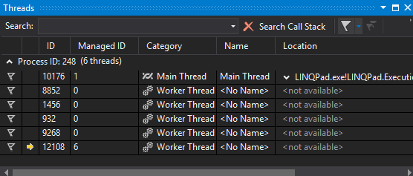
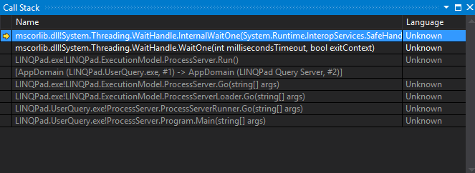
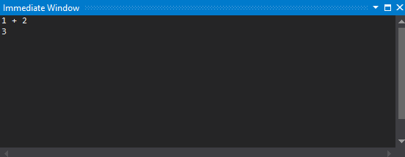
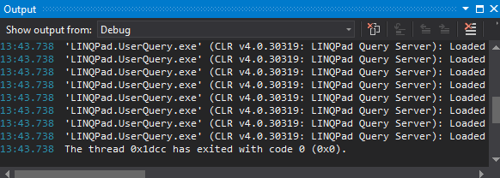
Useful VS tool windows
Threads: Ctrl-Alt-H
Call Stack
Immediate: Ctrl-Alt-I
Output:

Slide 13
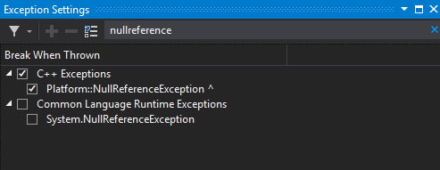
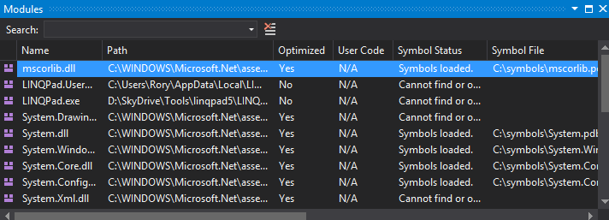
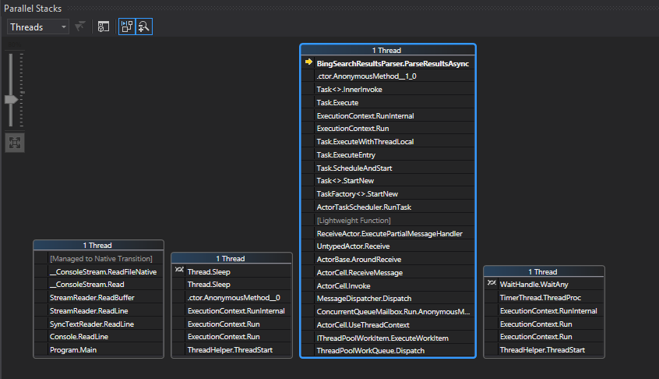
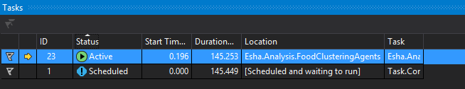
Useful VS tool windows
Exception Settings: Ctrl-Alt-E
Modules
Tasks: Ctrl-Shift-D, K
Parallel Stacks: Ctrl-Shift-D, S

Slide 14
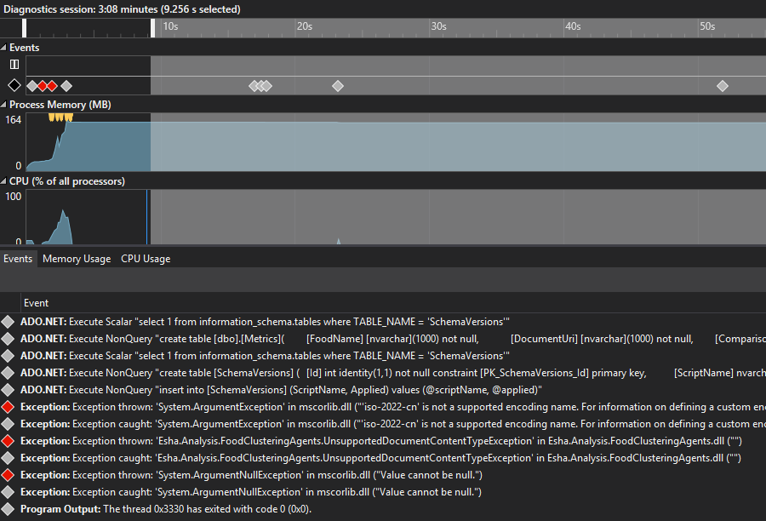
Intellitrace

Slide 15
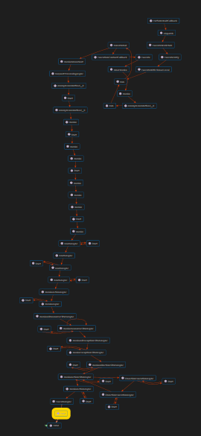
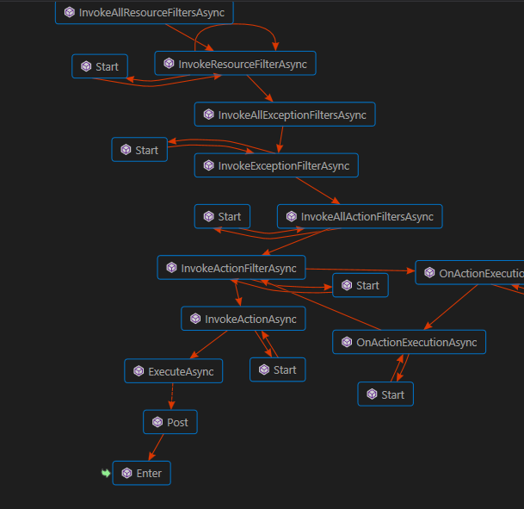
Code Map

Slide 16
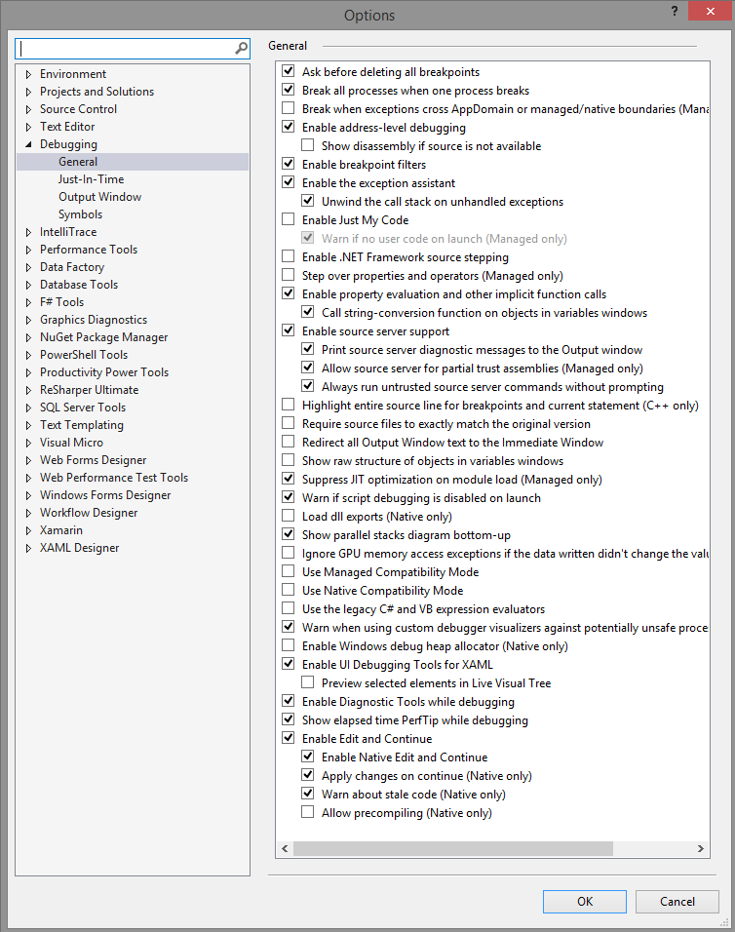
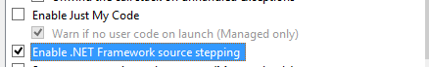
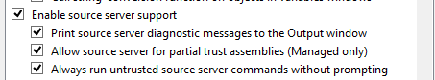
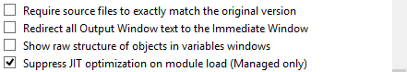
Visual Studio debugging options
Notes:
00:15

Slide 17
Breakpoints

Slide 18






Breakpoints 101
"Usual" breakpoints (F9) = Location breakpoints
Breakpoint on function name = Function breakpoints
Breakpoint with condition / filter = Advanced breakpoints
Breakpoint in script = Mapped breakpoints
Icons Enabled Disabled | Indicates
 | Location breakpoint / Function breakpoint
 | Advanced breakpoint
 | Mapped breakpoint
 | Tracepoint
 | Advanced tracepoint
 | Mapped tracepoint
 | Breakpoint cannot be set (breakpoint set error)
 | Breakpoint source cannot be found (breakpoint set warning)

Slide 19
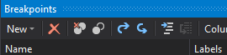
Breakpoints – Import / Export

Slide 20
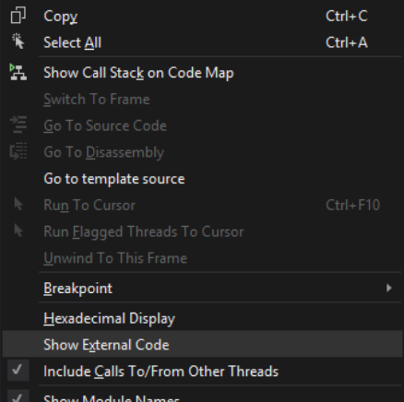
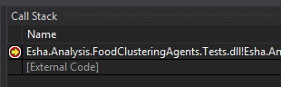
Breakpoints – Navigate Call Stack

Slide 21
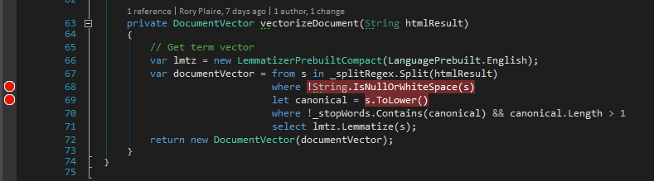
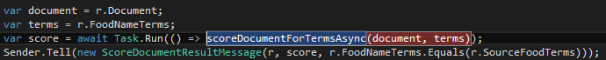
Breakpoints – Sub Expressions

Slide 22
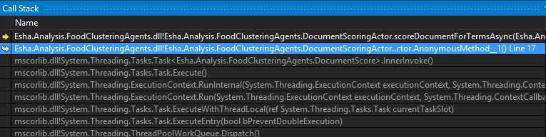
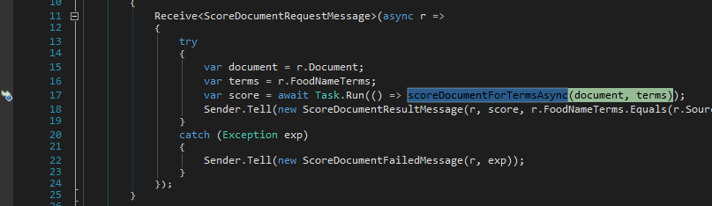
Breakpoints – Run To Cursor

Slide 23
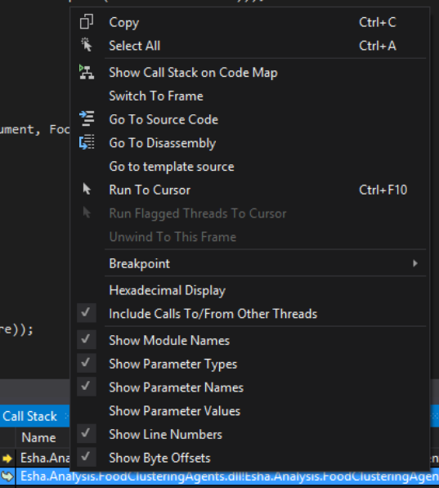
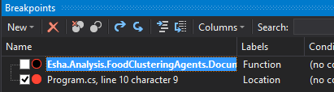
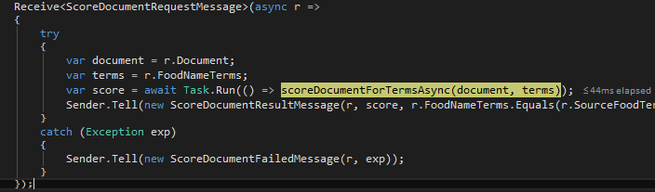
Breakpoints – Run To Cursor

Slide 24
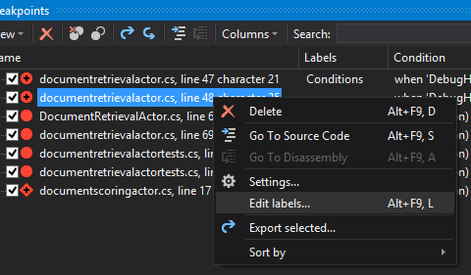
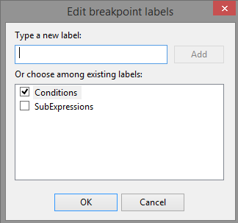
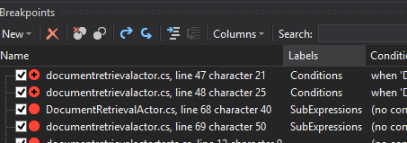
Breakpoints – Labels

Slide 25
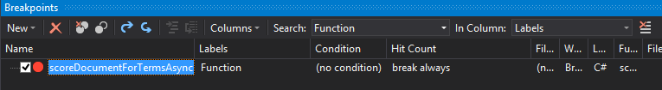
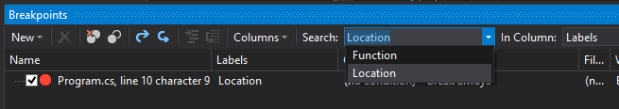
Breakpoints – Searching and Filtering

Slide 26
Function Breakpoints

Slide 27
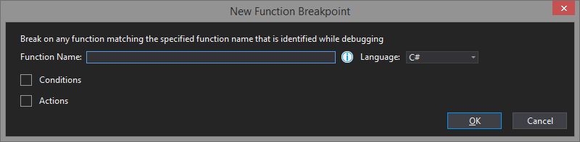
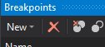
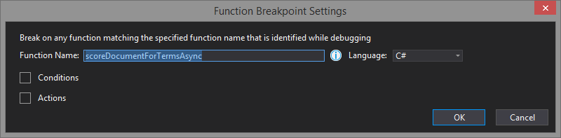
Function Breakpoints – Stop Magically
Notes:
Answer to: "How do I set a breakpoint if I don't have the source?
Symbol / Source Server setup
Add bp to function name
Async methods don't appear to work with Function Breakpoints
Add ctor to get source file
Beware optimization
.NET Framework Debugging Control ini file
COMPLUS_ZapDisable=1

Slide 28
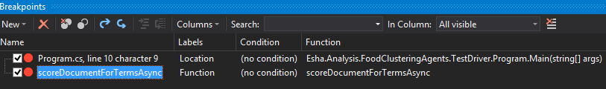
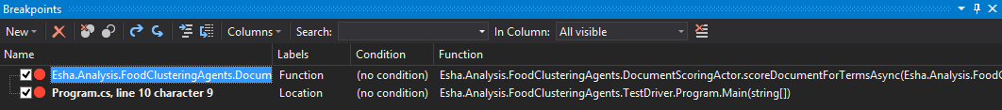
Function Breakpoints – Stop Magically
Notes:
Answer to: "How do I set a breakpoint if I don't have the source?
Symbol / Source Server setup
Add bp to function name
Async methods don't appear to work with Function Breakpoints
Add ctor to get source file
Beware optimization
.NET Framework Debugging Control ini file
COMPLUS_ZapDisable=1

Slide 29

Function Breakpoints – Stop Magically
How about: "No"
-JIT Optimization

Slide 30
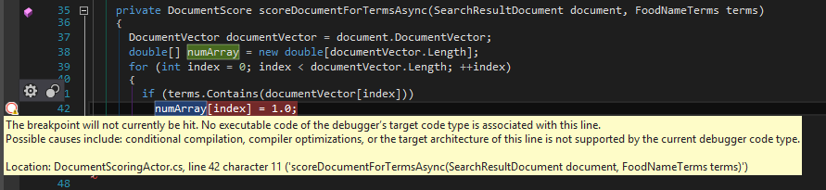
Optimization breaks debugging

Slide 31
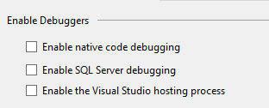

Function Breakpoints – Disable Optimizations
COMPLUS_ZapDisable=1
<assembly name>.ini
[.NET Framework Debugging Control]
GenerateTrackingInfo=1
AllowOptimize=0

Slide 32

Function Breakpoints – Disable Optimizations
COMPLUS_ZapDisable=1
<assembly name>.ini
[.NET Framework Debugging Control]
GenerateTrackingInfo=1
AllowOptimize=0

Slide 33
Function Breakpoints – Disable Optimizations

Slide 34
Tracepoints

Slide 35
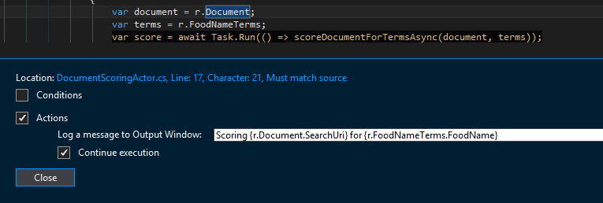
Tracepoints
Variable binding: {x}

Slide 36
Tracepoints
Token | Meaning
$ADDRESS | Current instruction
$CALLER | Calling function name
$CALLSTACK | Call stack
$FUNCTION | Current function name
$PID | Process id
$PNAME | Process name
$TID | Thread id
$TNAME | Thread name
$TICK
$TNAME

Slide 37
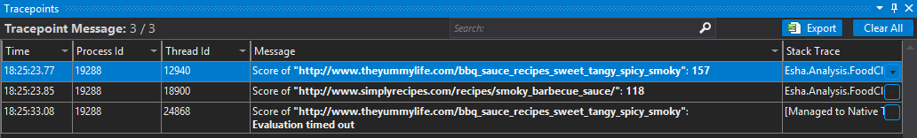
Tracepoints
Ozcode recording

Slide 38
Conditions

Slide 39

Code inside your breakpoints

Slide 40
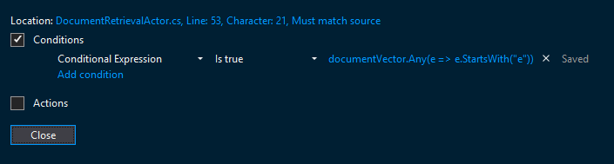
Code inside your breakpoints

Slide 41
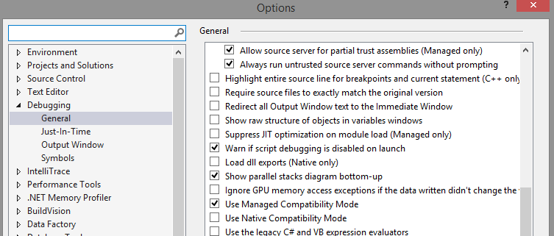
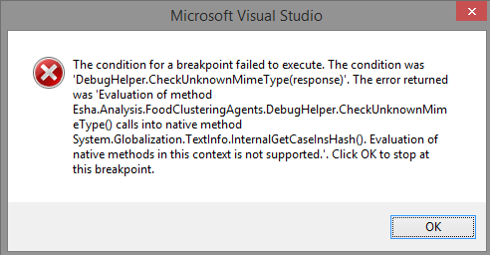
Advanced Breakpoints: Conditions
Notes:
00:25

Slide 42
Object ID

Slide 43
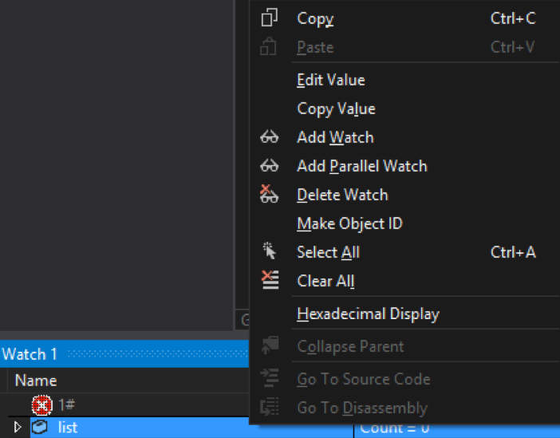
Object ID – Make one today!

Slide 44


Object ID - Referencing
$1 in new debugger; 1# in old debugger

Slide 45
Watch Window

Slide 46
Watch Window Expressions
Side effects
Executes in debugged process
Must execute in 20 seconds

Slide 47

Watch Window Expressions

Slide 48


Watch Window – Change State

Slide 49
Immediate Window

Slide 50

Immediate Window – Evaluate
Notes:
Do mutli example

Slide 51

Immediate Window – Assign
Notes:
Do mutli example

Slide 52

Removing whitespace to get better debugging information
Notes:
00:40

Slide 53
Display Code Attributes
DebuggerDisplayAttribute
DebuggerTypeProxy
DebuggerBrowsable

Slide 54
[Conditional("DEBUG")]

Slide 55
Debugger.Break
Debugger.IsAttached
Notes:
00:45

Slide 56
See Code
https://github.com/codekaizen/AdvNetDebugging/FoodNameClustering/
Notes:
00:45

Slide 57

The backdoor to your code at runtime: PDBs
Notes:
00:50

Slide 58
PDBs make nicer exceptions

Slide 59
PDBs make nicer exceptions
// Computes and returns the stack trace as a string
// Attempts to get source file and line number information if needFileInfo
// is true.
private string GetStackTrace(bool needFileInfo)
{
…
// Obtain the stack trace string. Note that since Environment.GetStackTrace
// will add the path to the source file if the PDB is present and a demand
// for FileIOPermission(PathDiscovery) succeeds, we need to make sure we
// don't store the stack trace string in the _stackTraceString member variable.
String tempStackTraceString = Environment.GetStackTrace(this, needFileInfo);
return _remoteStackTraceString + tempStackTraceString;
}

Slide 60
What's in a PDB?
Guid
Age
Symbol names
Mapping from generated code offsets to symbols
Source file
Source references

Slide 61
What's in a .Net PDB?
Guid
Age
Symbol names
Mapping from generated code offsets to symbols
Source file
Source references

Slide 62
How to manage your PDB files?
Delete them
Ship them
Nuget Symbol Package
Source Server

Slide 63
How to manage your PDB files?
Delete them
Ship them
Nuget Symbol Package
Source Server

Slide 64

Setup source server: TeamCity

Slide 65

Setup source server: TeamCity

Slide 66


Setup source server: Visual Studio

Slide 67

Setup source server: Visual Studio

Slide 68


Setup source server: Visual Studio

Slide 69



Symbols Don't Load

Slide 70

Symbols Don't Load

Slide 71


Symbols Don't Load

Slide 72


PDBs Don't Match
Rebuild same source code; Use previous EXE or PDB

Slide 73
PDBs Don't Match
Symchk / Chkmatch
Notes:
TestDriver SymCheck.ps1

Slide 74

PDBs Don't Match

Slide 75

PDBs Don't Match

Slide 76

You can't find your PDB files.

Slide 77


I Gotchu Fam
Notes:
00:55

Slide 78


Ad-hoc PDB Generation
Notes:
00:55

Slide 79
DevOps: crashing in production

Slide 80

You can not have Visual Studio on the server. You get nothing!
Good day, sir!

Slide 81

= Tools/AdvancedNetDebugger.psm1

Slide 82

Install Windows SDK
C:\Program Files (x86)\Windows Kits\10\Debuggers

Slide 83

Install Windows SDK
Missing?
C:\Program Files (x86)\Windows Kits\10\Debuggers\Redist

Slide 84
Memory Dumps

Slide 85

Getting a Memory Dump - Procdump

Slide 86

Getting a Memory Dump - Procdump

Slide 87

Getting a Memory Dump - Procdump
Notes:
Crashy Procdump.ps1
Hangy ProcDump.ps1

Slide 88
Getting a Memory Dump - Procdump
New-HangDump
New-CrashDump

Slide 89

Getting a Memory Dump - Procexp

Slide 90

Debugging Memory Dumps – Visual Studio

Slide 91



Debugging Memory Dumps – Visual Studio

Slide 92

Debugging Memory Dumps – Memprofiler

Slide 93

Debugging Memory Dumps – Memprofiler

Slide 94

Debugging Memory Dumps – Windbg

Slide 95


Debugging Memory Dumps – Windbg

Slide 96
Automating Analysis of Memory Dumps
Get-DumpAnalysis
https://github.com/Wintellect/WintellectPowerShell

Slide 97
Logging in Production

Slide 98

Logging in Production – Danger!

Slide 99
ETW

Slide 100

Logging in Production - ETW

Slide 101
Logging in Production - ETW
Start-EtwDataLogging
Stop-EtwDataLogging

Slide 102
GFlags

Slide 103

Logging in Production - GFlags

Slide 104

Logging in Production - GFlags

Slide 105
Logging in Production - GFlags
2260:07ec @ 694485375 - LdrLoadDll - ENTER: DLL name: C:\Windows\SYSTEM32\MSCOREE.DLL DLL path: NULL
2260:07ec @ 694485375 - LdrpLoadDll - ENTER: DLL name: C:\Windows\SYSTEM32\MSCOREE.DLL DLL path: C:\Program Files
2260:07ec @ 694485375 - LdrpLoadDll - INFO: Loading DLL C:\Windows\SYSTEM32\MSCOREE.DLL from path C:\Program Fi
2260:07ec @ 694485375 - LdrpFindOrMapDll - ENTER: DLL name: C:\Windows\SYSTEM32\MSCOREE.DLL DLL path: C:\Prog
2260:07ec @ 694485375 - LdrpSearchPath - ENTER: DLL name: C:\Windows\SYSTEM32\MSCOREE.DLL DLL path: C:\Program
2260:07ec @ 694485375 - LdrpResolveFileName - ENTER: DLL name: C:\Windows\SYSTEM32\MSCOREE.DLL
2260:07ec @ 694485375 - LdrpResolveFileName - RETURN: Status: 0x00000000
2260:07ec @ 694485375 - LdrpResolveDllName - ENTER: DLL name: C:\Windows\SYSTEM32\MSCOREE.DLL
2260:07ec @ 694485375 - LdrpResolveDllName - RETURN: Status: 0x00000000
2260:07ec @ 694485375 - LdrpSearchPath - RETURN: Status: 0x00000000
2260:07ec @ 694485391 - LdrpMapViewOfSection - ENTER: DLL name: C:\Windows\SYSTEM32\MSCOREE.DLL
ModLoad: 746a0000 746ea000 C:\Windows\SysWOW64\MSCOREE.DLL
(2260.7ec): Access violation - code c0000005 (first chance)

Slide 106
Logging in Production - GFlags
Enable-StartWithDebugger
Disable-StartWithDebugger

Slide 107
Fusion

Slide 108


Logging in Production - Fusion

Slide 109



Logging in Production - Fusion

Slide 110

Logging in Production - Fusion

Slide 111
Logging in Production - Fusion
Enable-FusionLog
Disable-FusionLog

Slide 112


For more
Notes:
01:10

Slide 113
For more
Tess Ferrandez - https://blogs.msdn.microsoft.com/tess/
John Robbins - http://www.wintellect.com/devcenter/author/jrobbins
Tom Christian - https://blogs.msdn.microsoft.com/tom/
Notes:
01:10

Slide 114
Code:
https://github.com/codekaizen/AdvNetDebugging/
Tools:
http://is.gd/Aqc2KR

